Slide 1

HTML/CSS
DAY 3- Introduction to CSS

Slide 2
What is CSS ??
Cascading Style Sheets,fondly referred to as CSS,is a simple design language intended to simplify the process of making web pages presentable.
CSS handles the look and feel part of the web pages. Using CSS you can control the color of the text,size of image,background color and images and many more things.
CSS is easy to learn and understand but it provides powerful control over the presentation of an HTML document.

Slide 3
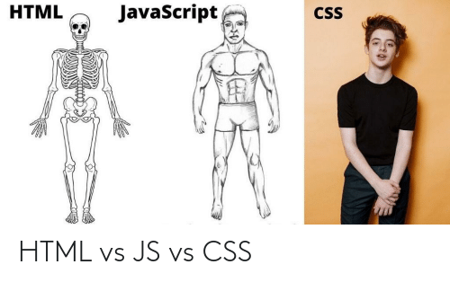
Why CSS ??

Slide 4
3 Types of method to apply CSS 1. Inline CSS <h1 style=“color:red;”> Hello </h1> 2. Internal CSS <head> <style> p { color:red; } </style> </head>

Slide 5
3. External CSS in style.css file p { color:red; }

Slide 6
CSS Syntax selectors:-
A CSS comprises of style rules that are interpreted by the browser and then applied to the corresponding elements in your document. A style rule is made of three parts −
i. Selector − A selector is an HTML tag at which a style will be applied. This could be any tag like <h1> or <table> etc.
ii. Property − A property is a type of attribute of HTML tag. Put simply, all the HTML attributes are converted into CSS properties. They could be color, border etc.
iii. Value − Values are assigned to properties. For example, color property can have value either red or #F1F1F1 etc.

Slide 7
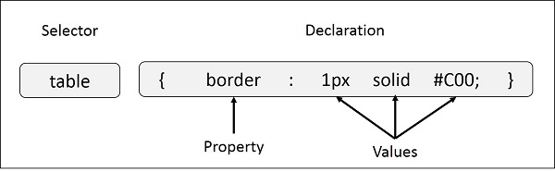
SYNTAX

Slide 8
The ID Selectors You can define style rules based on the id attribute of the elements. All the elements having that id will be formatted according to the defined rule. #black { color: #000000; } This rule renders the content in black for every element with id attribute set to black in our document. You can make it a bit more particular.

Slide 9
The Class Selectors
You can define style rules based on the class attribute of the elements. All the elements having that class will be formatted according to the defined rule. For example-
.black
{
color: #000000;
}
This rule renders the content in black for every element with class attribute set to black in our document. You can make it a bit more particular.

Slide 10
Grouping Selectors
You can apply a style to many selectors if you like. Just separate the selectors with a comma, as given in the following example −
h1, h2, h3 {
color: #0a192c;
font-weight: 20px;
}
This define style rule will be applicable to h1, h2 and h3 element as well. The order of the list is irrelevant. All the elements in the selector will have the corresponding declarations applied to them.

Slide 11
Different Properties of css
Background
Margins and Padding
Height / Width
Font-Size
Color
Links
Hover
Many More

